Slide 1

Microsoft Orleans
Sit Dolor Amet

Slide 2
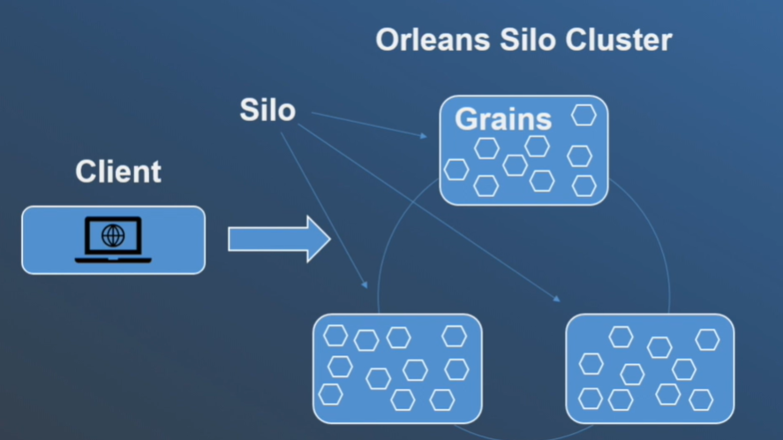
Microsoft Orleans
Orleans is a framework that provides a straightforward approach to build distributed, high scale computing applications without the need to learn and apply complex concurrency or other scaling patterns.
Orleans provide an intuitive way of building Stateful middle tier.
Various business logical entities appear as a sea of isolated global addressable .NET objects called grains.
Of different applications defined types distributed across cluster of servers called Silos.

Slide 3
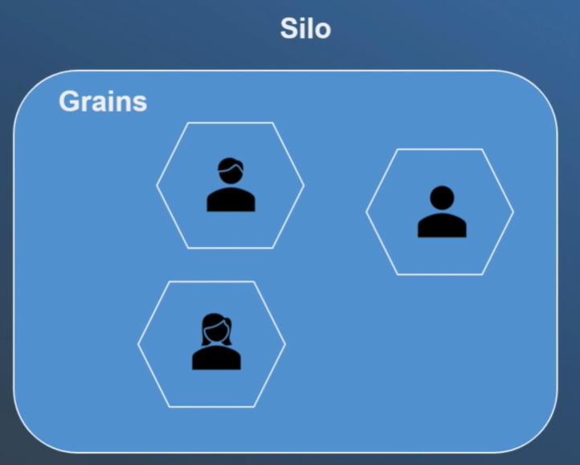
GRAINS
A grain type is a simple .NET class that implements one or more application type defined grain interfaces.
Individual grains are instances of application defined grain classes that get automatically created by Orleans runtime on servers. On needed basis to handle requests for those grains.
Grains naturally map to most application entities such as user, device, sessions, inventories.
These makes easy to build business logic that is object-oriented but scales transparently to a cluster of servers.

Slide 4
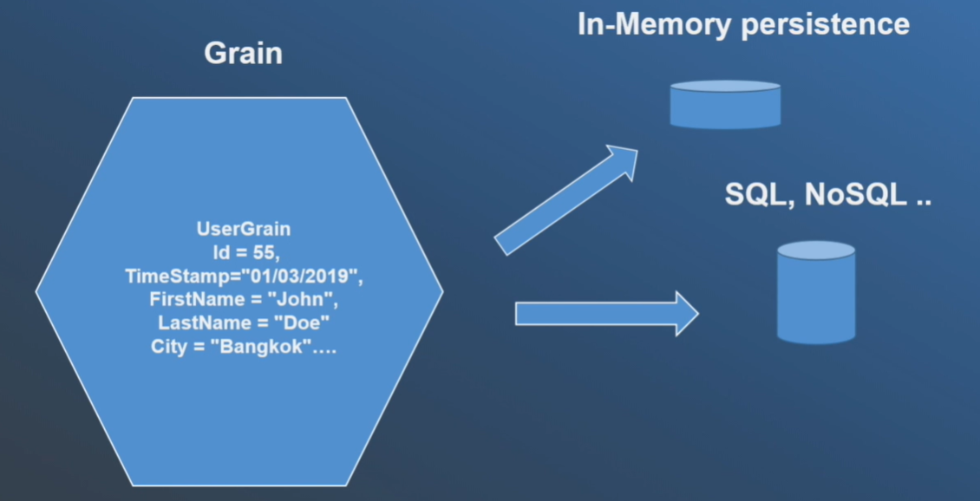
GRAIN
Each grain has a stable logical identity. Within its grain type chosen by the application logic.
For example: User email, Device ID
Orleans guarantees single thread execution of each individual grain and protects application logic from concurrency and race condition.
A grain can have a persistence storage. It can be in memory state or both.
Any grain can be called by other grain or frontend. By using targets grain logic identity without the need to ever create or instantiate a target grain.
The Orleans programming model make grains appear as if they are in the memory for the whole time.
In reality, the grain goes through the lifecycle from existing or from persisted state in a storage to be instantiated in a memory/being removed from memory.
Behind the scenes, the Orleans runtime instantiates the grains whenever there is a work for them to do. Removes them from the memory to reclaim hardware resources when the grains are idle or their for too long.

Slide 5
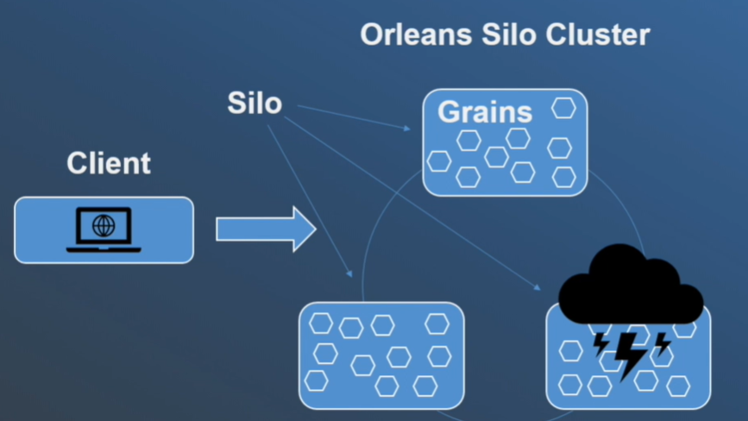
Failure of grains
In addition, the virtual nature of grains allows Orleans to handle server failures mostly transparently through application logic.
Because grains that were executing on fail server will automatically instantiate grains on the other servers in the cluster once the failure is detected,

Slide 6
App Setup and configuration

Slide 7
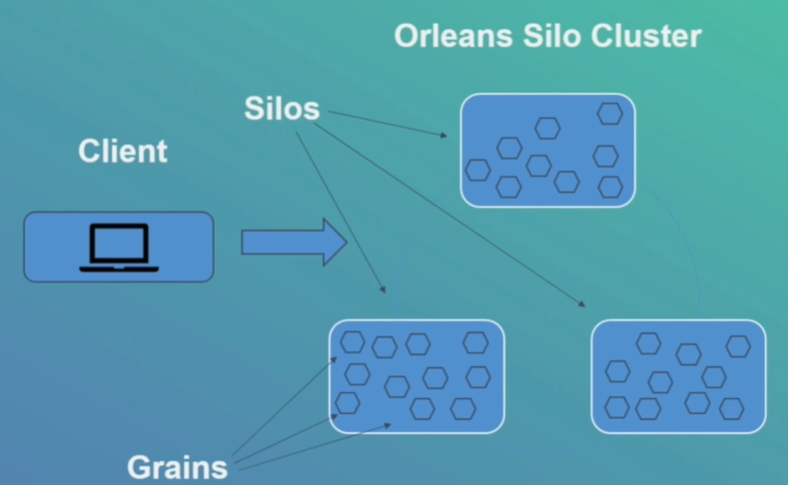
Silo
The term silo is used for application that houses grains. You can call it as Silo server.
Silos are used in the Cluster.
Client acts as connector to the silos and to the grains of the application.

Slide 8
Orleans APP STRUCTURE
Orleans App Structure | Nugets
Silo | Microsoft.Orleans.Server
Grains | Microsoft.Orleans.Core.Abstractions – Contains types implemented in Orleans runtime. Microsoft.Orleans.CodeGenerator.MSBuild
Interfaces | Microsoft.Orleans.Core.Abstractions Microsoft.Orleans.CodeGenerator.MSBuild

Slide 9
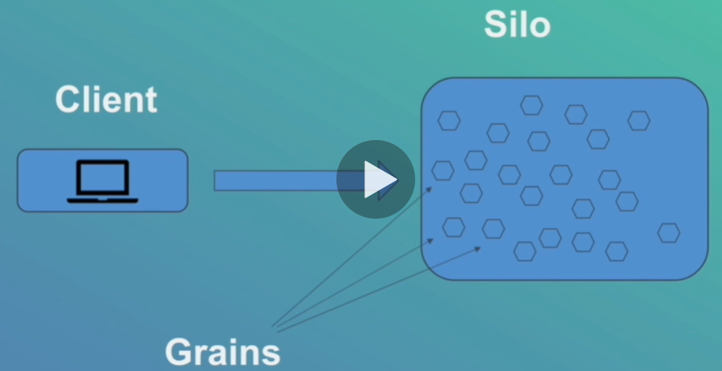
Grain CLIENT
The term client is used for application code that interacts with grains. But that is itself not part of business logic.
Client code runs outside of silos where grains are hosted.
Grain Client acts as a connector to Silos and to all grains of the application.
Usually, the clients are used at frontend webservers to connect to Orleans silos which serve as middle tier.
The silos are hosting grains executing their business logic.

Slide 10
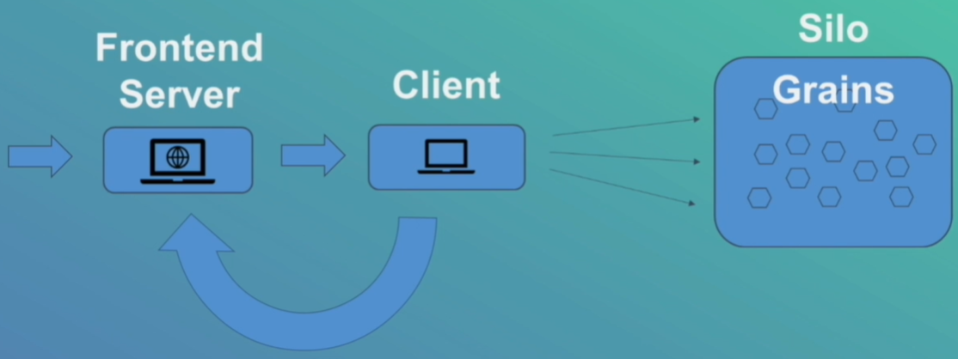
Client configuration
In a typical setup, the frontend webserver receives the web request.
Frontend server performs necessary authentication, authorization, validation and these kind of things. It then decides
which grains should process the request.
Frontend server uses grain client to make one or more method calls to the grains.
Client handles the logic and sends back the response to the frontend server.
Before a grain client can be used for making calls to the grains hosted on Orleans silo, it needs to be configured and
initialized at silo.

Slide 11
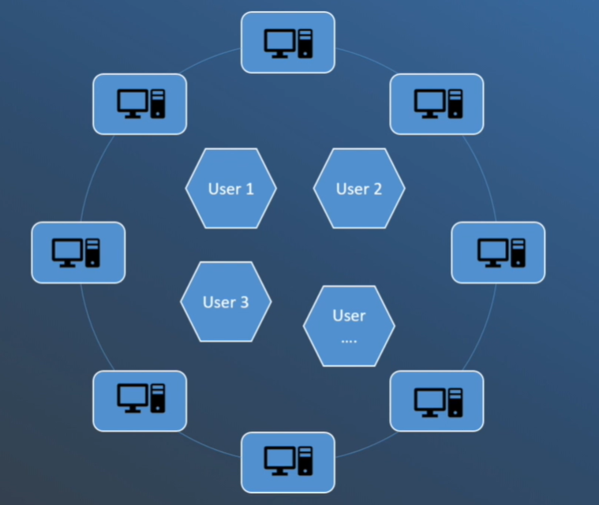
Create GRAIN
Grains are objects that represent application entities. They are encapsulating state and encoding its behavior in the core
logic.
For example : We have multiple users with ID’s. Exactly one user will occupy one grain with the same user ID. Exactly one user
will occupy one grain with the same user ID. This user grain will hold all the info about the user.
It is kept in memory and so it is superfast. All the grains are automatically handled by Orleans. We don’t need to worry
about instantiation and management of grains.
Grains are single threaded, so no locks

Slide 12
Grain IDENTITY
Grain must have identity for the system to able to recognize it, to activate it, to deactivate it and in general to work with it.
Therefore, grains have primary key.
The following can be the primary keys:
long
GUID
string
GUID + string
long + string
Compounded Key’s are GUID + string and long + string
GUID’s are useful when they are several processes that could request the grain.
The primary keys are scoped to the Grain type. Therefore, the complete identity of Grain is formed from the Grain’s type
and its key.
You don’t need to coordinate occasion of keys. For instance, huge number of webservers contacting Orleans. There is very
low chance of GUID’s colliding.
long is useful when grain is persisted into relational database wherein numerical id’s are preferred
Compound keys are for special cases when long, GUID and string are not enough.

Slide 13
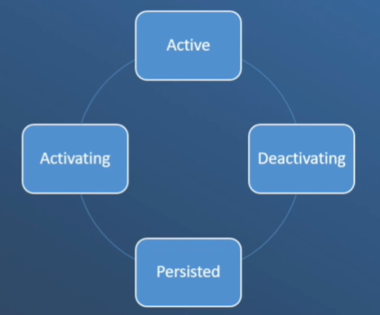
Grain LIFECYCLE
Grains live in execution container called Silos. Multiple Silos are forming Cluster.
When a request for the Grain comes, Orleans ensure that there is an instance for the grain on one of the Silos inside the
cluster.
If there is no instance Orleans creates one. This process is called as activation.
Grains can keep state in some form on persistence. SQL, NoSQL and others.
When Grain is activated, it means that Grain is put into memory and is using Grain persistence. It will load the state from
persistence (SQL or NoSQL or Others). All the requests are handled from the memory.
If the Grain stops receiving the request and stays idle after configurable period of inactivity, then Orleans deactivates it.
To free up resources for other Grains and it is going to persist state to SQL and this Orleans control this behavior.
Developer assumes that Grains are always UP.

Slide 14
Grain LIFECYCLE
The sequence works as follows when request comes to the Grain:
Grain gets activated if it is not available.
Constructor is called and executes Dependency Injection.
If Grain storage is used then Grain reads state from the storage.
OnActivateAsync method is called.
Than Grain is able to process requests. So basically, Grain works
If Grain stays idle then it means that work is done. No more requests.
Orleans deactivates Grain. It means that it removes from the memory.
Calls OnDeactivateAsync method. In this method we can implement our custom logic.
Grain writes to storage
Grain removed from memory.

Slide 15
Polly
Polly is a resilient library which allows us to express policies such as
Retry
Circuit Breaker
Timeout
Cache
Fallback
… (Tons of others)
Client sometimes try to connect to Silo and Silo is unavailable (Still loading or whatever).
Silo is throwing exceptions like Silo unavailable exception and others. We can give client more tries.

Slide 16
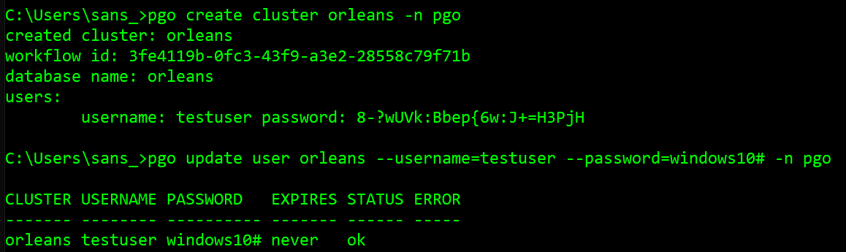

GRAIN PERSISTENCE
There are many storage providers that are ready to be used like Azure Storage, Azure DynamoDB Storage and many others.
We are going to use ADO.Net provider and PostgreSQL
https://dotnet.github.io/orleans/docs/host/configuration_guide/adonet_configuration.html
Create “Orleans” database cluster in PostgreSQL

Slide 17
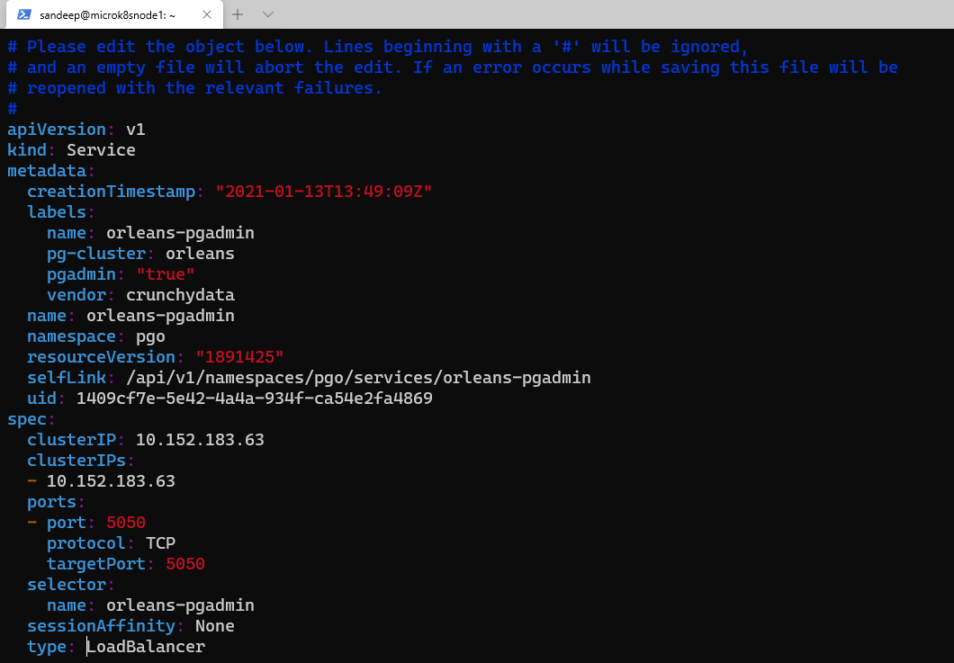
PG ADMIN – Change TO LOADBALANCER

Slide 18
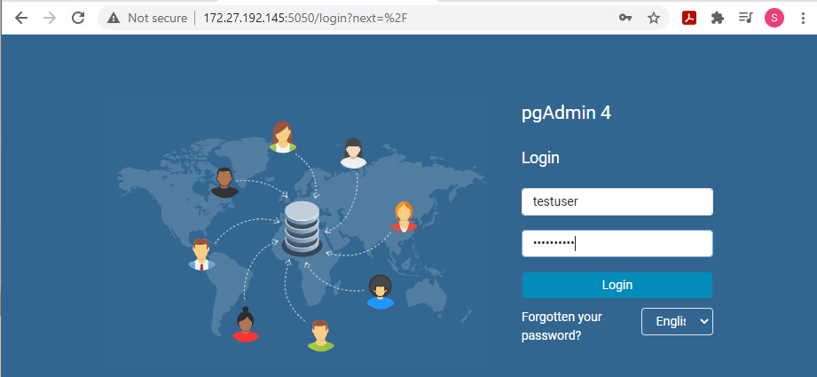
LogiN INTO PGADMIN

Slide 19
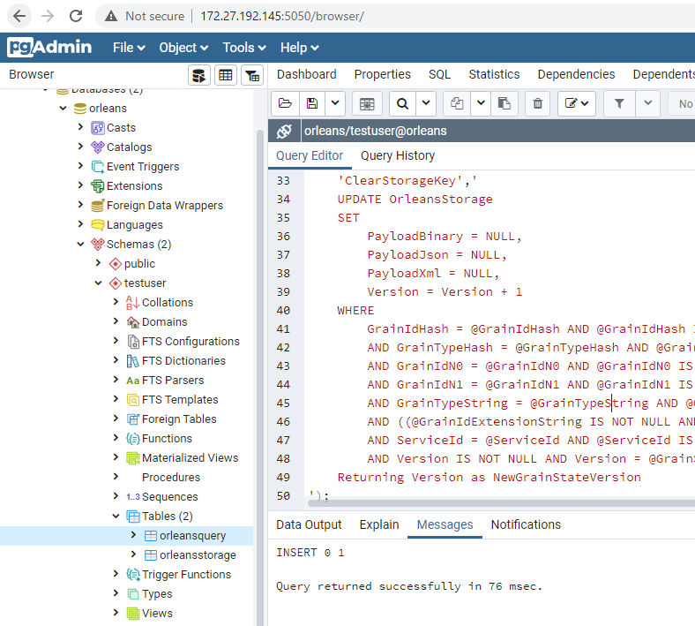
PostgreSQL SCRIPT
Main Link:
https://dotnet.github.io/orleans/docs/host/configuration_guide/adonet_configuration.html
Execute Main Script :
https://github.com/dotnet/orleans/blob/master/src/AdoNet/Shared/PostgreSQL-Main.sql
Execute Persistence Script :
https://github.com/dotnet/orleans/blob/master/src/AdoNet/Orleans.Persistence.AdoNet/PostgreSQL-Persistence.sql

Slide 20
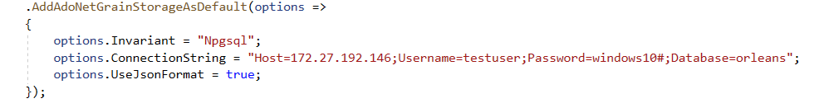
SILO Persistence

Slide 21
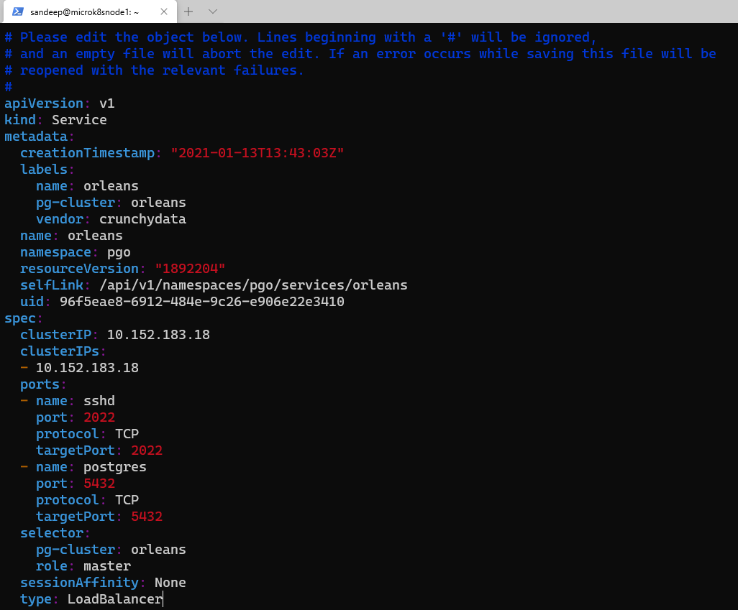
ORLEANS – Kubernetes SERVICE to loadbalancer

Slide 22
Automatic SQL Scripts deployment with dbup library
In the previous slides, we must manually run two SQL scripts to create DB structure for grain persistence.
https://dbup.readthedocs.io/en/latest/
DbUp is a .NET library that helps you to deploy changes to SQL Server databases. It tracks which SQL scripts have been
run already and runs the change scripts that are needed to get your database up to date.

Slide 23
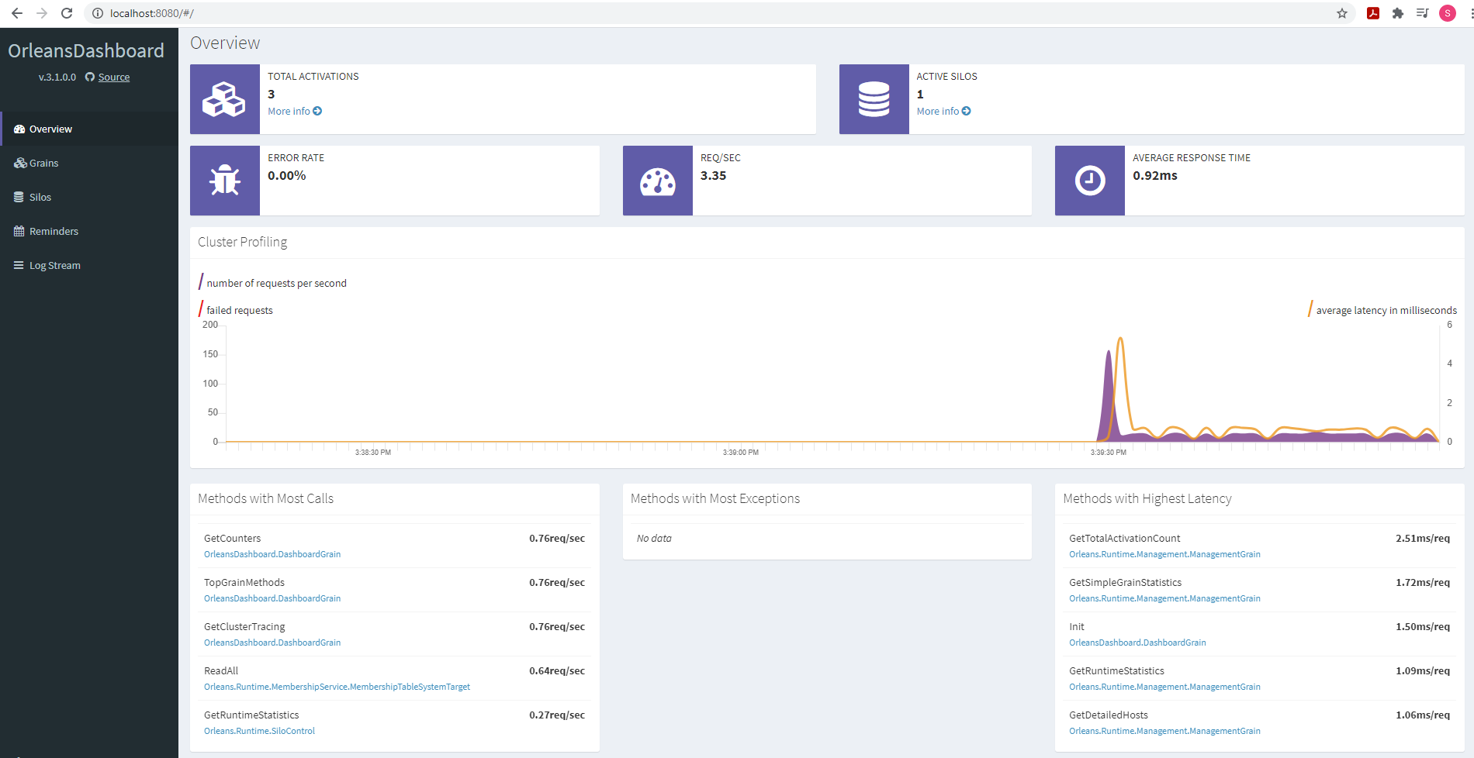
Orleans DASHBOARD (Internal monitoring tool)
It is simple and give us serious insight into Orleans.

Slide 24
Grain call filters
Grain call filters provide a means for intercepting grain calls.
Filters are coming in two flavors : Incoming call filters & Outgoing call filters.
They can be used in many scenarios such as authorization Filter can inspect method being invoked and decide if the
user can proceed with the call; login can log a piece of information about method and of course error handling.

Slide 25
REQUEST CONTEXT
Request Context is an Orleans feature that allows application metadata, such as trace ID or whatever we need to pass, to
flow with requests to the receiving grains or a chain of grians.

Slide 26
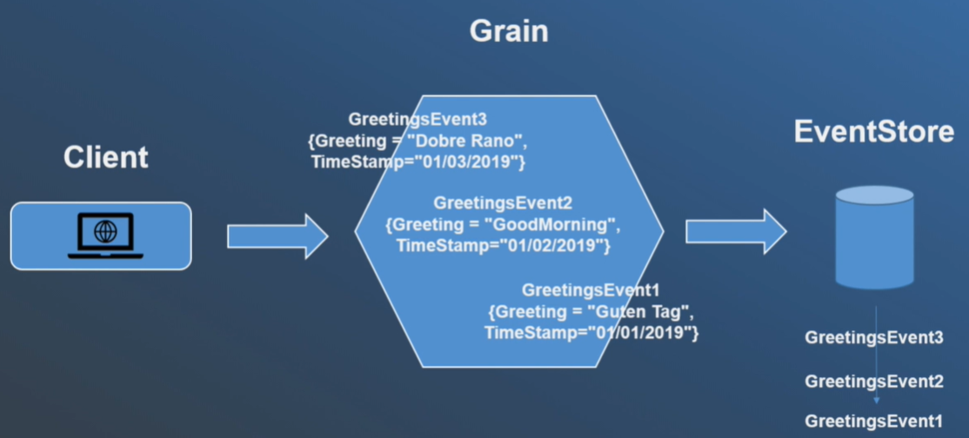
Event Sourcing
Event sourcing ensures that all changes to the application state are stored as a sequence of events. Not just query these
events or even walk to construct the past states.
The fundamental idea of event sourcing is that ensuring every change to the state of an application is captured in an event
object. This event object is stored in sequence that we applied for the same lifetime as the application state itself.
The most important thing in event source is that we have a log of all changes. Not just that we can see order of events and
write to a log file whenever event occurs.
In this client posting Greeting events to the Grain. Each of these Greeting event holds Greeting and TimeStamp.We know
that event reached the Grain. Any time, the object reaches the GRAIN then it will be stored in EventStore for that method.
It will give an ordered event object.

Slide 27
JOURNALED GRAIN
Imagine Event Sourcing is a stream of events. There is a possibility to touch each of the events or reply to the whole set
of events which already happened.
This gives us great flexibility in programming where exactly knows what happened and when happened. Useful for
debugging. In this case, we are going to implement saving of latest event. We are going to store it in the table of
relational database.

Slide 28
EVENT STORE
Event Store is a stream database which stores data as immutable series of events and directly supports event sourcing.
https://www.eventstore.com/downloads#releases

Slide 29
Graceful SHUTDOWN of silo
It is useful for preparation of Clustering.
When Ctrl + C is pressed, it will generate cancel event. The application will exit immediately causing a catastrophic silo
clash and loss of memory state.
With a little of magic, we can prevent application causing before application save state and performs graceful shutdown.

Slide 30
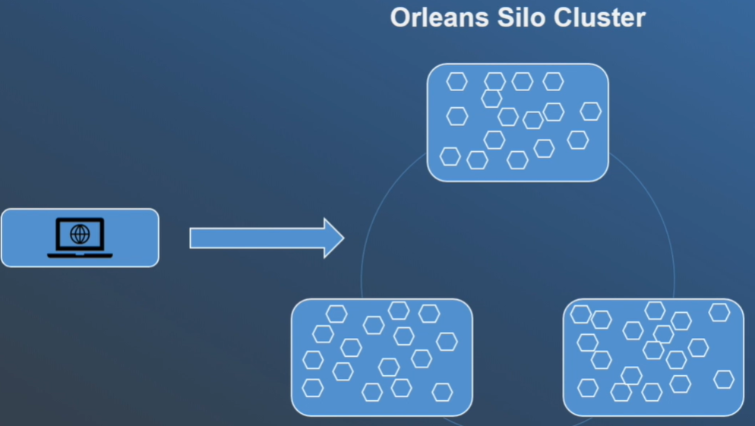
Orleans clustering with ADO.net
Orleans clustering is based on built-in membership protocol.
Silos are agreeing on currently live silos. They detect failed ones and allow new silos to connect to the cluster.
On Startup, each Silo writes to membership table.
All Silos ping with each other with messages called heart-beats.
If one Silo starts pinging, then other silos will decide that one silo is not responding. They write a suspicious state to
membership table. One suspicion is not enough to decide that silo is dead.
All the silos need to conform that Silo is dead.
https://github.com/dotnet/orleans/blob/master/src/AdoNet/Orleans.Clustering.AdoNet/PostgreSQL-Clustering.sql
(orleansmembershiptable, orleansmembershipversiontable)

Slide 31
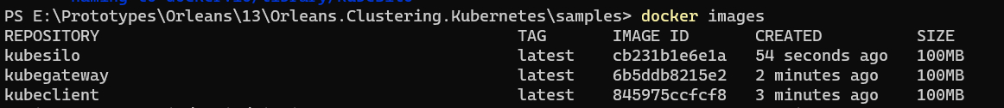
Orleans in KUBERNETES
https://github.com/OrleansContrib/Orleans.Clustering.Kubernetes/tree/master/samples

Slide 32
Custom RESOURCE DEFINITIONS

Slide 33
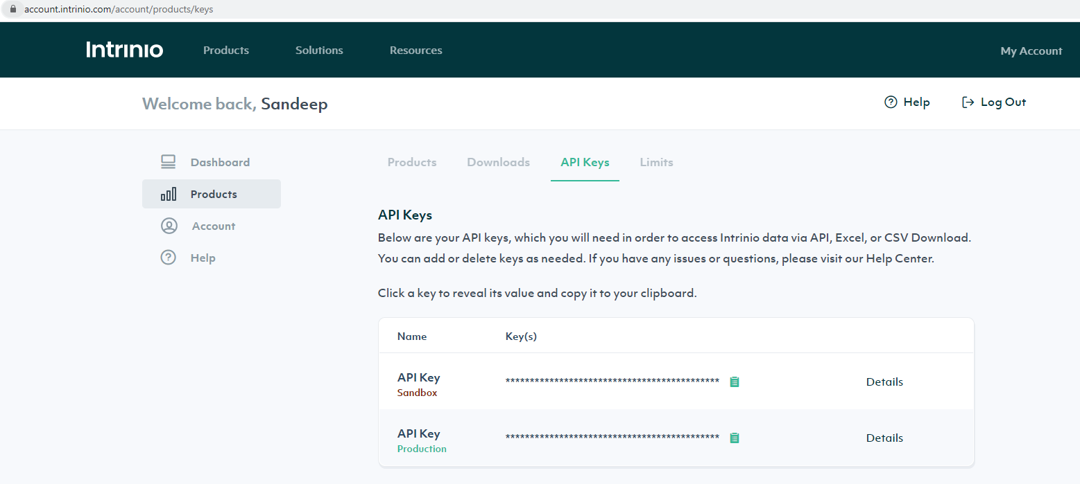
INTRINio
Intrinio is a financial data api which offers wide range of analytical, historical and real-time info. Beginning with stocks
and ending with securities.
https://github.com/intrinio/csharp-sdk/blob/master/docs/SecurityApi.md#getsecurityrealtimeprice

Slide 34
Timers
Timers allow us to trigger periodic grain behavior. For example : Like to do in 10 secs.
Timer is valid only in grain activation scope. This means timer is bound to grain with specific key. One key associate with
one activation.
Any time, the grain is deactivated, the timer is lost. This issue being solved with Reminders.

Slide 35
GRAIN SERVICE
Grain service is a special grain without identity. It is running in every silo from Startup to Shutdown.
Grain service are single threaded like normal grains except concept of reentrance.
Cons:
One grain service cannot handle more than one request at the same time before previous request is finished.

